Slide 1
Introduction to OOP
New way of thinking…
Stole the tagline from ColdFusion :P

Slide 2
Let’s try modeling a real world situation…
Robots in a Warehouse

Slide 3

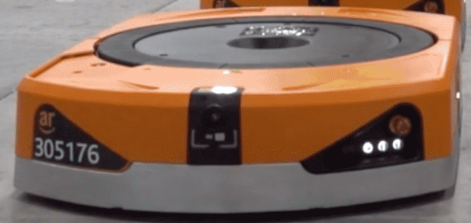

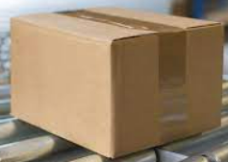
Let’s say you have a warehouse in which you have an autonomous robot that moves around packages and cartons.

Slide 4
The robot moves to the package.

Slide 5
It picks up the package through its imaginary arms.

Slide 6
And then brings it to the warehouse supervisor for further processing.

Slide 7
We saw this situation… How do we start about writing a program for it?
Think about the data and the functions we will require.
dropPackage()
Package position (x and y)
approachPackage()
Supervisor position (x and y)
liftPackage()
moveRobot()
Robot position (x and y)
approachHuman()

Slide 8
We saw this situation… How do we start about writing a program for it?
This is what we’ve done thus far…
Procedural Programming
dropPackage()
Package position (x and y)
approachPackage()
Supervisor position (x and y)
liftPackage()
moveRobot()
Robot position (x and y)
approachHuman()

Slide 9
We saw this situation… How do we start about writing a program for it?
However, there could be potential problems.
Programmatically, you could have passed package position (x and y) to moveRobot() because the function just expects two integers.
In fact, could have given it two random integers, and it would run its procedures on it.
Package position
int x
int y
moveRobot(int x, int y)
Robot position
int x
int y

Slide 10
We saw this situation… How do we start about writing a program for it?
There is no “relationship” between this function and the particular two integers of the robot’s position.
The data and the functions are independent from one another.
You, the programmer, needs to ensure that everything works as intended. It is your responsibility!
Package position
int x
int y
moveRobot(int x, int y)
Robot position
int x
int y
Notes:
The idea of “Shift of Responsibility”.

Slide 11
We saw this situation… How do we start about writing a program for it?
What if we could somehow establish this ‘relationship’, however?
If we could, then we can be sure that moveRobot() will only accept the robot’s position as an input even if we forced an error.
Package position
int x
int y
moveRobot(int x, int y)
Robot position
int x
int y

Slide 12
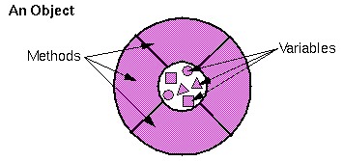
Enter Objects
You could establish this relationship if you somehow combined, or encapsulated, the functions with the related data in a single entity.
These entities are what we refer to as objects.

Slide 13
Now let’s implement our warehouse in OOP
Identify objects.

Slide 14
Imagine you are trying to simulate this warehouse.
What entities can you spot in this situation?

Slide 15
Identifying Objects
These are some of the objects that could be identified.
Ground Robot
Warehouse
Package
Supervisor

Slide 16

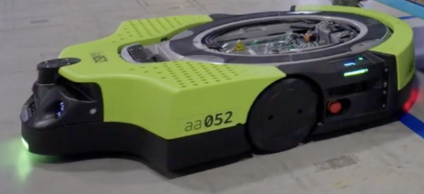
Let’s say this warehouse had many grounded robots.
And each robot had their own supervisor as well.
Both these entities, become new objects.

Slide 17
Identifying Objects
These are some of the objects that could be identified.
Ground Green Robot
Ground Orange Robot
Warehouse
Package
Male Supervisor
Female Supervisor

Slide 18
Identifying Objects
We are getting closer to how we will write this programmatically…
Ground Orange Robot
Every object encapsulates data and behaviors.
Because moveRobot() is now associated with the robot object, you can no longer pass in other data directly.
So the problem we saw earlier won’t happen here.
Data Color Battery left Position_x Position_y Max. Load And more… | Behaviors moveRobot() approachPackage() liftPackage() approachHuman() dropPackage() And more…

Slide 19
Identifying Objects
Back to our objects.
There seems to be one difficulty…
Ground Green Robot
Ground Orange Robot
Warehouse
Package
Male Supervisor
Female Supervisor

Slide 20
Identifying Objects
Considering every entity in our simulation to be a unique category could make life hard…
So I want to categorize them.
Ground Green Robot
Ground Orange Robot
Warehouse
Package
Male Supervisor
Female Supervisor

Slide 21
Identifying Objects
Employee Category
Male Supervisor
This could be one way we can categorize these objects.
Robot Category
Female Supervisor
Ground Orange Robot
Building Category
Warehouse
Ground Green Robot
Package Category
Carton

Slide 22
Identifying Objects
Employee Category
Male Supervisor
We have categorized or classified our objects.
Each category is a class.
Robot Category
Female Supervisor
Ground Orange Robot
Building Category
Warehouse
Ground Green Robot
Package Category
Carton

Slide 23
Enter Classes
A class is essentially a way to categorize objects.
In other words, a class is a template that tells us how objects (of this particular class) are created.
It defines all the data (variables) that an object will contain.
It defines all the functions (behaviors) that an object can perform.

Slide 24
Enter Classes
Very close to actually writing code…
Ground Orange Robot
In other words, all this information is defined inside a class.
And you create objects using classes (hence utilizing the information).
Data Color Battery left Position_x Position_y Max. Load And more… | Behaviors moveRobot() approachPackage() liftPackage() approachHuman() dropPackage() And more…

Slide 25
Enter Classes
Since classes are templates, they are not entities in their own right.
That is, they don’t occupy any space in memory (based on the context that we’ve been referring to memory).
They’re just blueprints.
Each object, however, is an instance of a class.
Objects are entities.
They do occupy space in memory just like variables and arrays do.

Slide 26
Interpretation of Classes as a Data Type
You can think of classes as a user-defined data type.
Just like an int or a double, you now have your own data type.
The programming language provides you with such primitive data types.
But because we’re trying to simulate the real world, primitive data types don’t complete the job effectively.
Classes help with this.

Slide 27
Independence of Data
Robot Category
Understand that an object’s data is independent of other objects’ data.
Each robot, for e.g. has their own color.
Spray painting (changing the color) of any robot will not change the color of all the robots of that class.
Each employee will have their own unique ID.
Ground Orange Robot
Ground Green Robot
Employee Category
Female Supervisor
Male Supervisor

Slide 28
Creating Classes and Objects in Code
Finally!

Slide 29
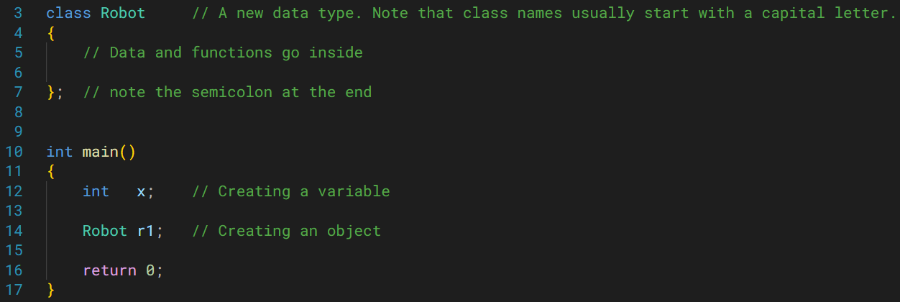
Creating a class and an object.

Slide 30
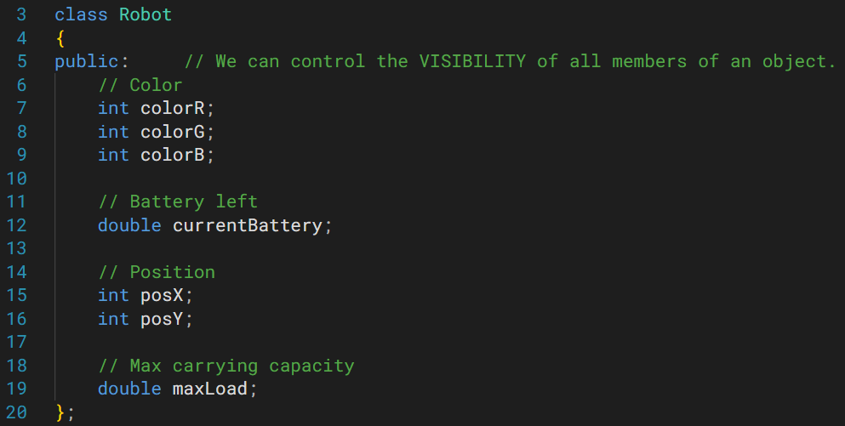
Adding the data, or the ATTRIBUTES, as they are called. Note the different data types.
Ground Orange Robot
Data Color Battery left Position_x Position_y Max. Load And more… | Behaviors moveRobot() approachPackage() liftPackage() approachHuman() dropPackage() And more…
QUESTION
Based on what we’ve seen thus far, do any ideas come to mind when you see these attributes?
We can create more data types!
Notes:
Public specifier isn’t the convention!

Slide 31
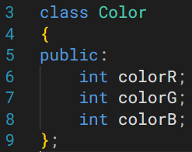
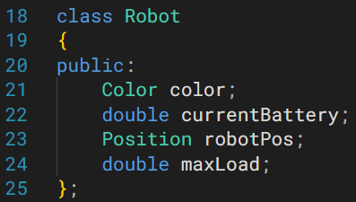
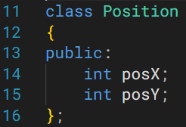
More classes!
May help in organizing data.
Robot now contains objects of Color and Position as attributes.
Objects can be an amalgamation of primitive as well as user-defined data types.
Side note
public visibility is not recommended for attributes.
We will replace this as we progress.
Notes:
Public specifier isn’t the convention!

Slide 32
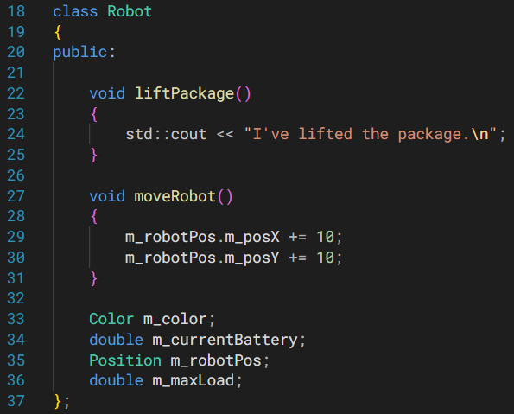
Now let’s add methods in our class definition.
Note
By convention, attribute names are prefixed by ‘m_’
This helps in differentiating between object’s attributes vs. other variables.
Side note
public visibility is not recommended for attributes.
We will replace this as we progress.

Slide 33
Accessing an Object’s Members
In order to access an object’s members (attributes or methods), use the dot operator.
Robot r1; // creating an object
r1.m_maxLoad; // accessing attributes
r1.m_liftPackage(); // accessing methods

Slide 34
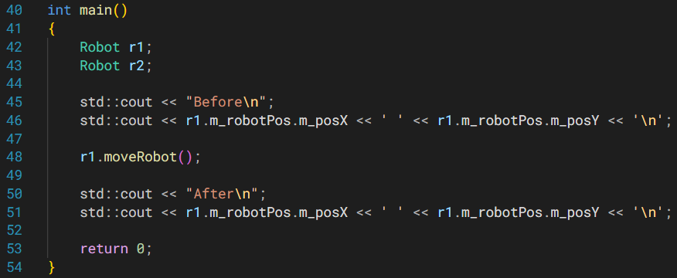
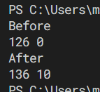
Side note
public visibility is not recommended for attributes.
We will replace this as we progress.
Notes:
The members inside a class can be written in any order.
Doesn’t matter what comes first.

Slide 35
Accessing an Object’s Members
In the last example, if I printed r2’s position attributes, after the function call was made, what would be their values?
Unaffected.
Reason: The data of different objects are independent from one another.

Slide 36
Calling Member Functions
Why does r2’s position (or attributes, in general) didn’t change?
Because data of r1 is independent from the data of r2!
This idea could be explained more…

Slide 37
Calling Member Functions
When you call a member function of an object, like so,
r1.moveRobot();
The object, r1, is implicitly passed to moveRobot().
moveRobot(&r1) // compiler does this for us.
And the attributes that you accessed within moveRobot() were of this implicit object (r1 in this case).

Slide 38
Calling Member Functions
That’s why the method knows that it needs to modify r1’s attributes.
Concept of this pointer.
Talk more later.

